Slide 1

FOREIGN DIRECT INVESTMENT DATA ANALYSIS
Detailed Project Report
Created by: Rishi Kalpa Mukherjee

Slide 2
PROJECT DETAILS
PROJECT TITLE | INVESTMENT ANALYSIS
Technology | Business Intelligence
Domain | Finance
Programming Language | Python
Tools | Jupyter Notebook, MS Excel, Tableau

Slide 3

OBJECTIVE
The goal of this project is to understand the Foreign direct investment in India for the last 17 years from 2000-01 to 2016-17.

Slide 4
PROBLEM STATEMENT
Investment is a game of understanding historic data of investment objects under different events but it is still a game of chances to minimize the risk we apply analytics to find the equilibrium investment.
To understand the Foreign direct investment in India for the last 17 years from 2000-01 to 2016-17. This dataset contains sector and financial year-wise data of FDI in India.
Sector-wise investment analysis
Year-wise investment analysis
Find key metrics and factors and show the meaningful relationships between attributes.

Slide 5
ARCHITECTURE
Raw Data Collection
Importing Libraries in Jupyter Notebook
Loading FDI Dataset
Data Pre-Processing
Intuitive Insights
Business Intelligence Tool - Tableau
Data Modelling
Exploratory Data Analysis(EDA)
Deployment
Reporting
Low-Level Design Document
High-Level Design Document
Architecture Document
Wireframe Document
Detailed Project Report

Slide 6
DATASET INFORMATION
The dataset contains Sector-Wise Investment Analysis and Year-Wise Investment Analysis data of India in respect to Foreign Direct Investment.

Slide 7
QUESTIONS AND ANSWERS
Q1. What's the source of data?
Ans. The dataset received from Ineuron.ai provided with all necessary details, files and documents of the project and its main objective and outcomes.
Q2. What are the Data-types?
Ans. The data was a combination of qualitative and quantitative values, aligning data types of attributes.
Q3. Show the complete data flow and architecture of the project?
Ans. Please check and refer the 5th slide for better clarity and understanding.
Q4. What techniques used in the data?
Ans. We performed important initial analysis of data, pre processed the data and executed EDA.
- Removal of unwanted variables.
- Removal of outliers.
- Data Cleaning and Imputing the null values.
Q5. What libraries used in Python?
Ans. Pandas, NumPy for mathematical computation and Seaborn, Matplotlib for data visualization has been used.

Slide 8
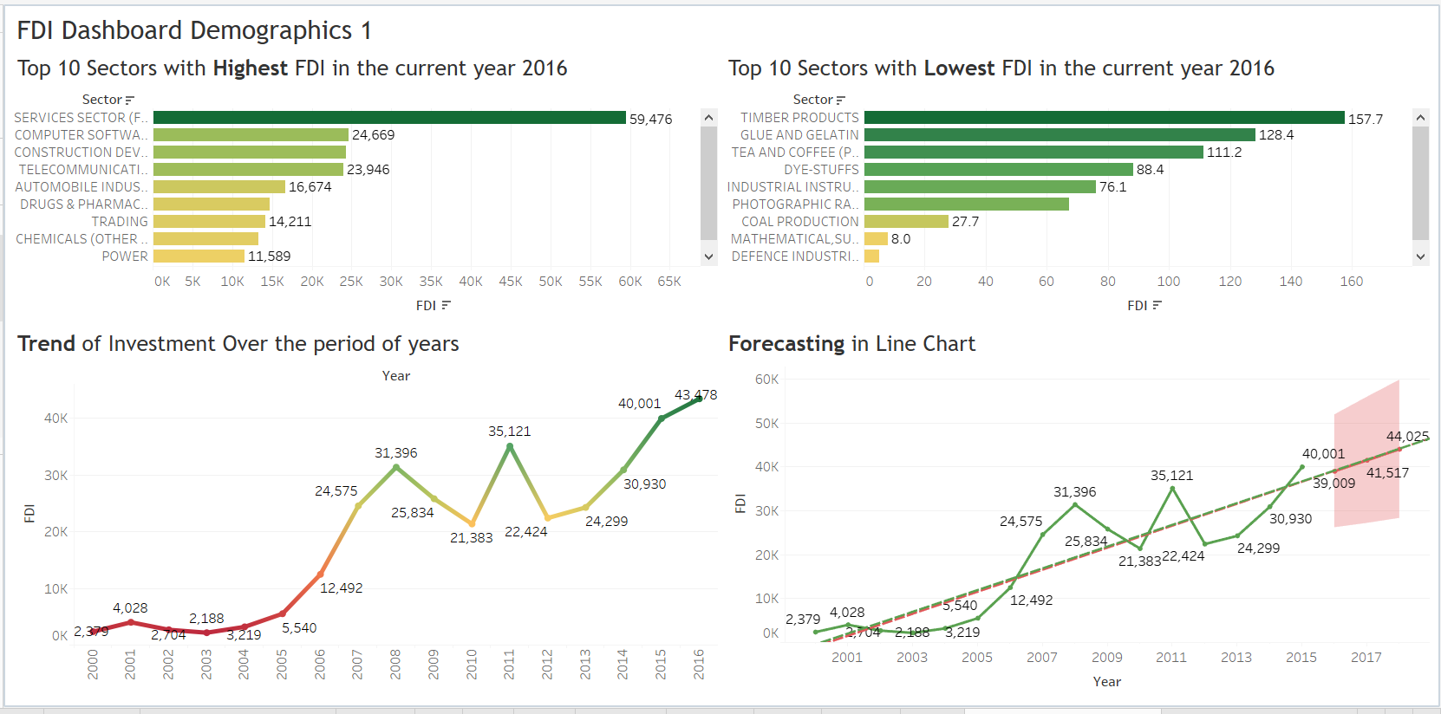
DASHBOARD DEMOGRAPHICS
Services Sector being the highest FDI contributor with 8684 followed by Telecommunication with 5564. Computer Software stands as 3rd highest sector in terms of FDI for the year 2016. Glue and Gelatin being the lowest FDI contributor with 90.60 followed by Dye-Stuffs with 10 in the year 2016. The highest FDI trend analysed in the year 2016 with 43478. The lowest FDI trends analysed in the year 2003 with 2188. The line chart shows the FDI India inflows of trends & patterns from 2000-01 to 2016-17. The line chart is in increasing trends from 2000 and the peak time is in the year 2008 which stands with 31396 where 2000 year which start with 2379. In between there was a flip ups and downs and fluctuations between 2009 to 2012 and dip down flow analysed in the year 2010 and 2012. Forecasting of the line chart has been analysed and predicted for the years 2017 to 2018 which would stand ranging between 41517 and 44025. Actual and Estimate Forecast indicator has been utilized to see the trend line.

Slide 9
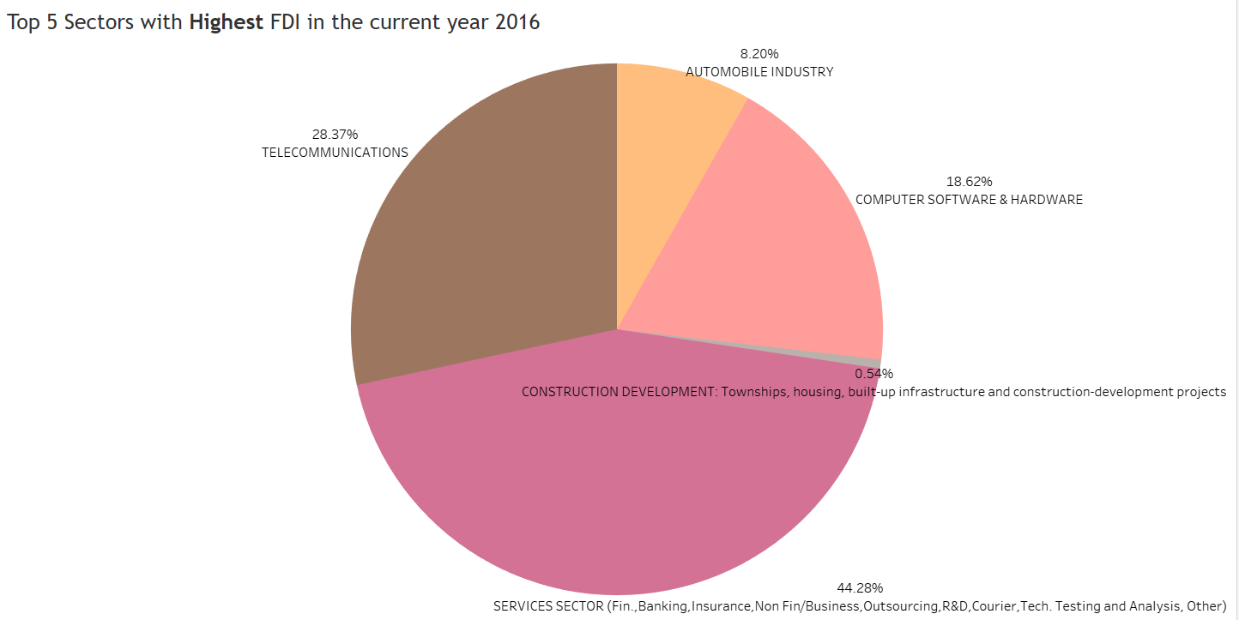
DASHBOARD DEMOGRAPHICS
Among Top 5 Sectors in respect to FDI, we analyzed and find out that SERVICES SECTOR has the highest and biggest FDI inflow having 44.28% followed by TELECOMMUNICATIONS having 28.37% standing on the second position, COMPUTER SOFTWARE AND HARDWARE on third position with 18.62%, so on and so forth.

Slide 10
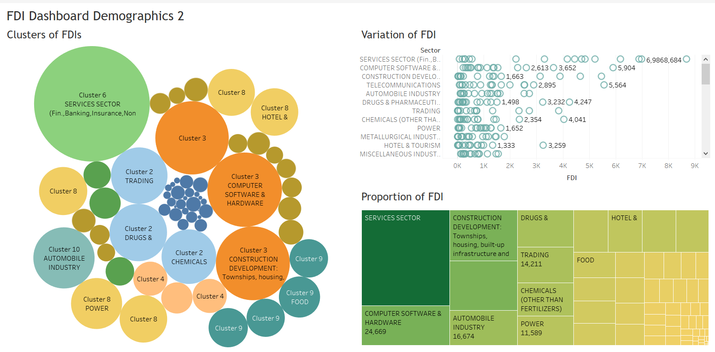
DASHBOARD DEMOGRAPHICS
Various Clusters of FDI has been implemented. Nearly 10 clusters has been made to see the segregation of various sectors of FDI. We can change the number of clusters based upon business requirements and expertise. Variations of Sectors has been analyzed. Proportions of FDI has been generated to check the Tree-Map of FDIs.

Slide 11
FOREIGN DIRECT INVESTMENT DATA ANALYSIS
End of Detailed Project Report
THANK YOU
RISHI KALPA MUKHERJEE

